Slide 1
Introduction to SQL and Basic Queries part 2
Inner Join
Left Join
Right Join
Full Join

Slide 2
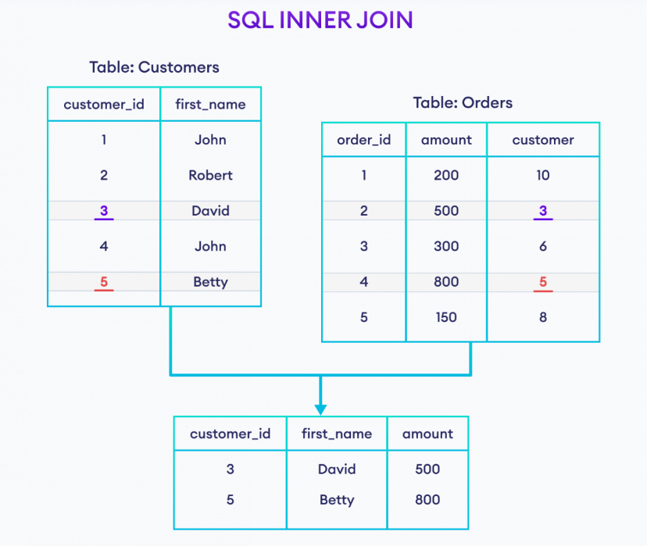


Slide 3
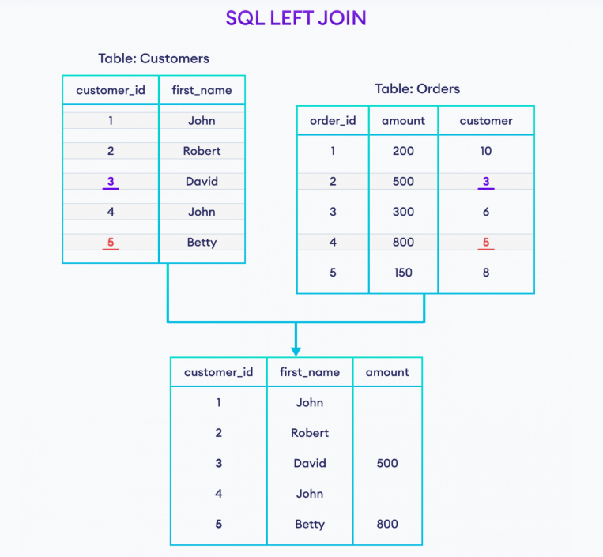


Slide 4
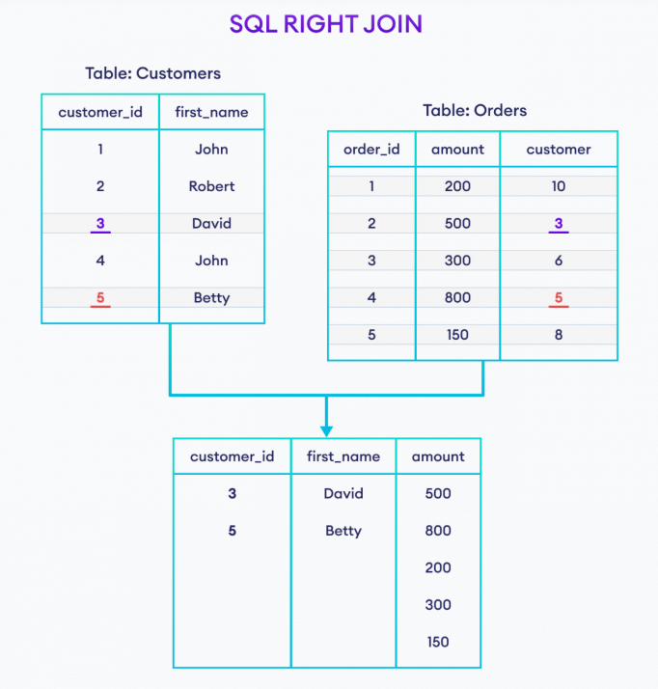


Slide 5
